Slide 1
Multivariate Analyses Part II
NRES 776

Slide 2
Learning Objectives
Explain what discriminant analysis can be used for
Describe when and why you could use classification, MANOVA, MRPP, and CART

Slide 3
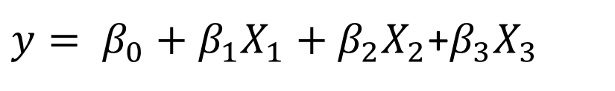

Univariate vs multivariate
Single response variable
Multiple response variable
$y= β_{0}+β_{1}X_{1}+β_{2}X_{2}$+$β_{3}X_{3}$
$$y=c(y_{1},y_{2},y_{3},y_{4})$$

Slide 4
Aims of multivariate statistics
Simplification, data reduction (ordination: PCA and NMDS)
Classification (discriminant analysis, cluster analysis)
Hypothesis testing (MANOVA, MRPP)
Structural modeling: Classification and Regression Trees

Slide 5
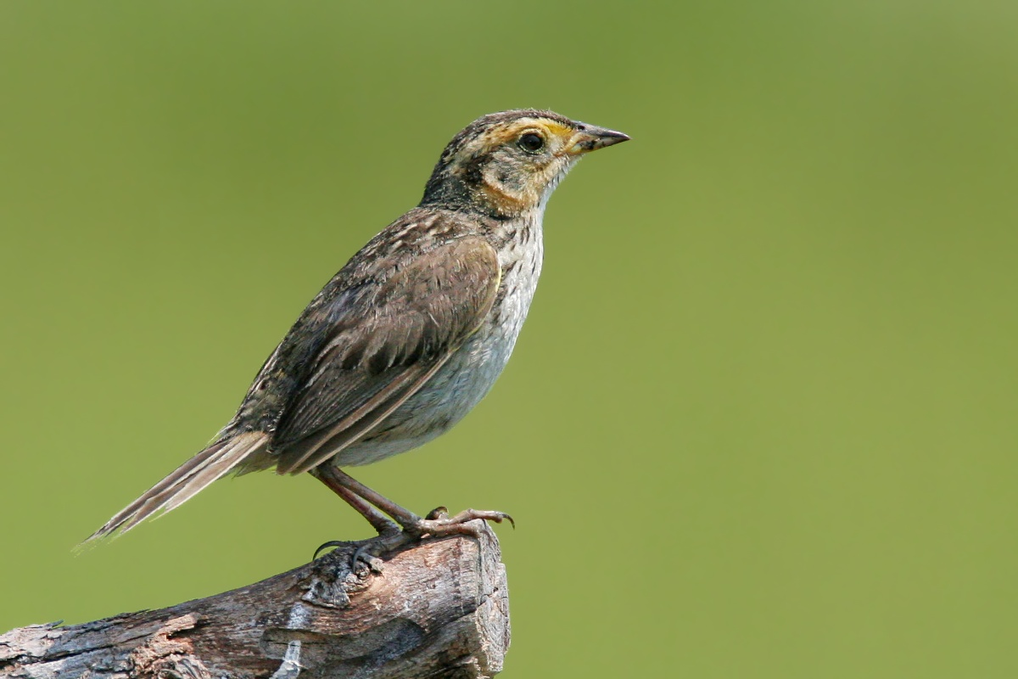
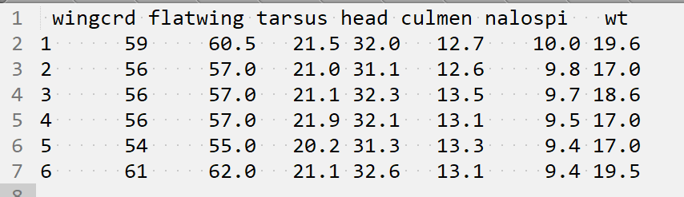
Discriminant Analysis
Morphometric data from saltmarsh sharp-tailed sparrows
7 variables, 1100 sparrows
Measurements taken by 10 observers
Do measurements differ by observer?
Observer
1
1
1
2
2
2
3
Notes:
Sparrow image: Wolfgang Wander - http://www.pbase.com/wwcsig/image/47346264

Slide 6
Discriminant Function Analysis
Used to determine whether groups differ based on a known grouping structure (Observer)
Can then be used to classify new observations into groups (Which observer made a new observation?)
Extension of linear regression (similar to logistic regression)

Slide 7
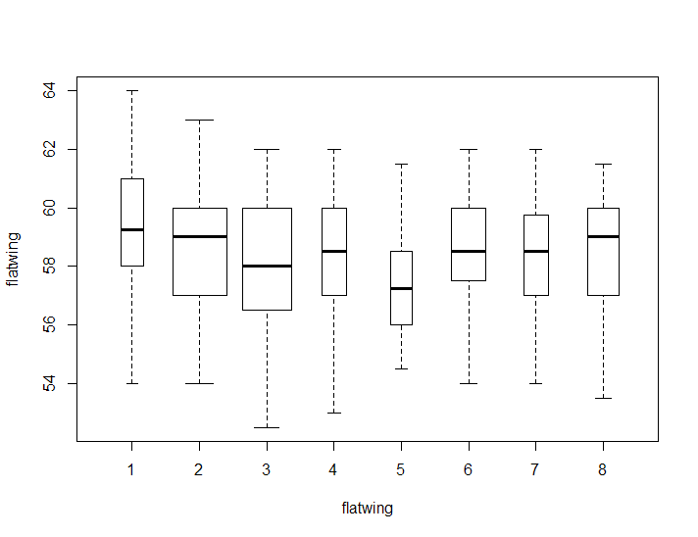
Discriminant Function Analysis
Is there evidence of observer bias? If so, which variables differ by observer?

Slide 8
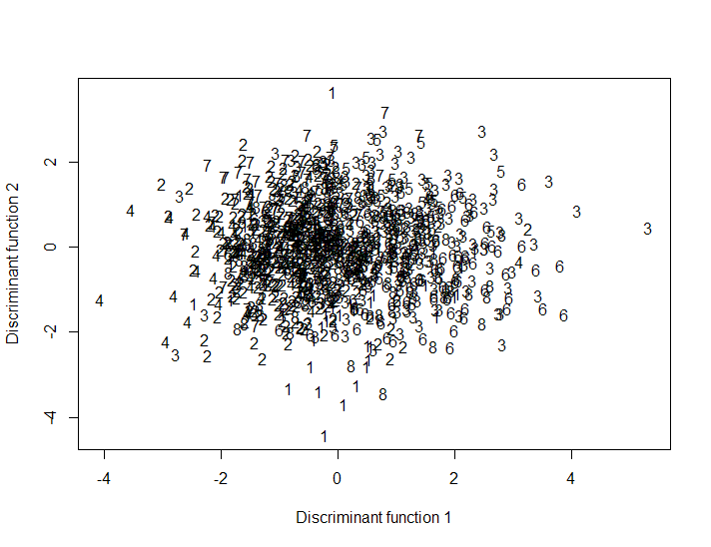
Discriminant Function Analysis
Finds axes that separate two or more previously identified groups
Finds axes that maximize variation among groups relative to variation between groups

Slide 9
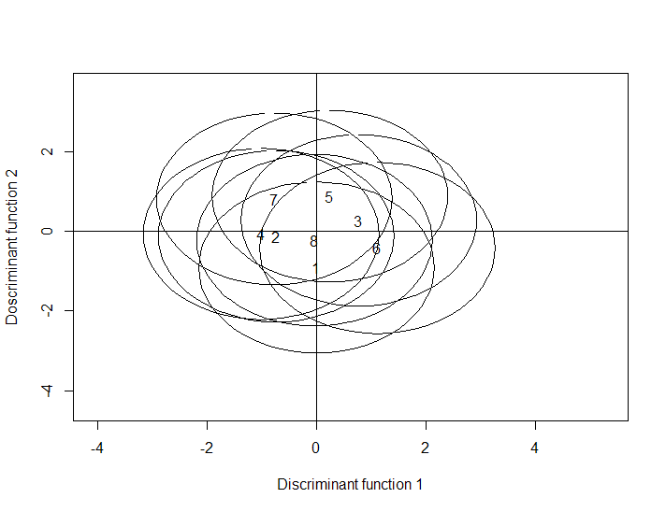
Discriminant Function Analysis
Plot of tolerance intervals for different observers (1-8). Circles define the range in which 90% of the population values are found

Slide 10
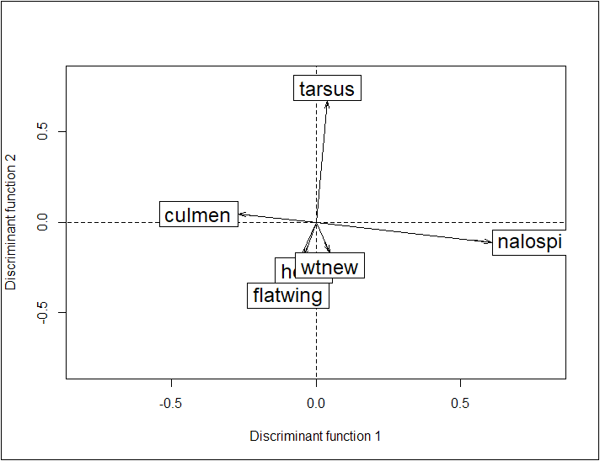
Discriminant Function Analysis
Plot showing correlation coefficients between axes and original variables
Can follow up with hypothesis testing to determine which variables differ among observers

Slide 11
Discriminant Function Assumptions
Observations can be divided a priori into at least two groups
At least 2 observations per group (ideally 4-5 times as many observations per group as the number of variables)
Number of observations in the smallest group is larger than the number of variables
Variables are continuous with linear relationships
No 100% collinearity (remove variables with r>0.9)
Homogeneity of variances and covariance matrices
Multivariate normality and independence of observations

Slide 12
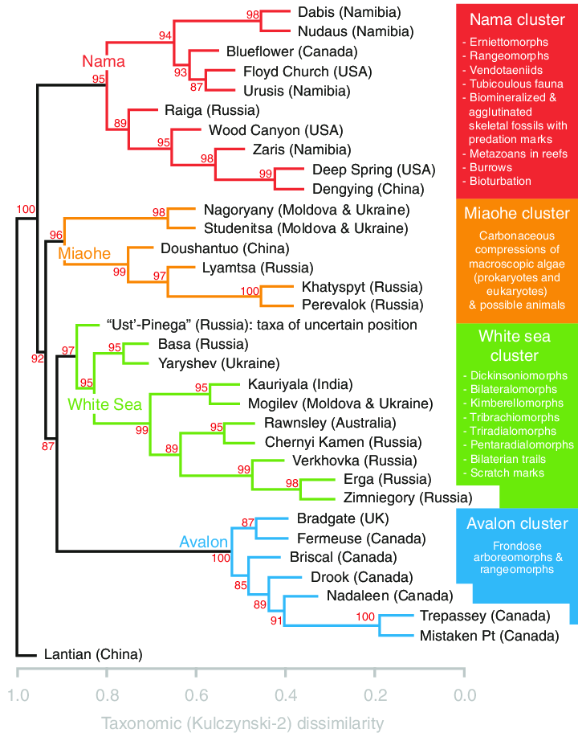
Classification
Used for defining groups (useful fiction)
Notes:
Hierarchical clustering with dendrogram of 34 geologic formations with 5 or more macrofossil genera from the Ediacaran age
From Muscente et al 2019. Ediacaran biozones identified with network analysis provide evidence for pulsed extinctions of early complex life

Slide 13
Classification
How it works:
Data are a matrix (e.g., taxonomic relatedness of different species)
Groups organisms so that similar organisms are grouped together
Uses chaining where 1 individual is added at a time
Variety of different algorithms available to create clusters
Can be hierarchical (groups composed of sub-groups) or non-hierarchical

Slide 14

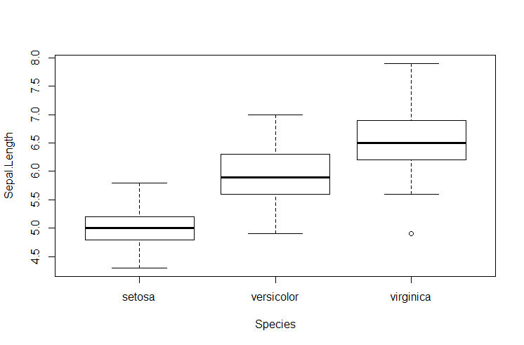
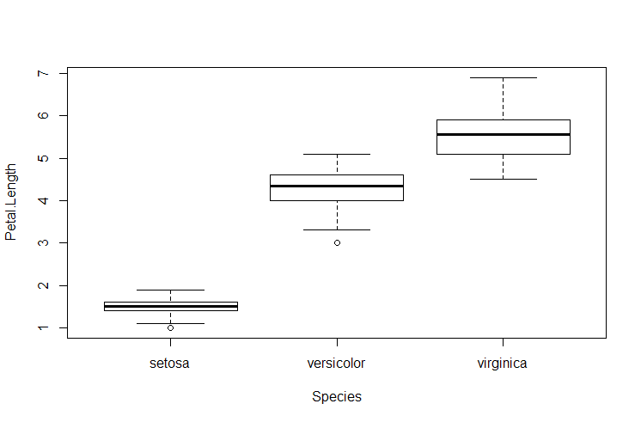
MANOVA and MRPP
Both Used for comparing groups
MANOVA: Multivariate Analysis of Variance
Extends ANOVA to multiple response variables
E.g., Do mean sepal length and width differ among iris species?

Slide 15
MANOVA and MRPP
MANOVA Assumptions:
Homogeneity of variance
Balanced design

Slide 16
MANOVA and MRPP
MRPP: Multi-response Permutation Procedure
Non-parametric alternative to MANOVA
Tests differences among groups (not means!)
No assumptions about the distributions (i.e., homogeneity of variances)
Procedure uses a permutation test where the test statistic is computed with original data
Data are then shuffled randomly, test statistic is calculated again
Procedure repeated many times and used to generate a frequency distribution

Slide 17
Classification and Regression Trees
Kind of multivariate regression
Powerful machine learning approach
Similar to glm approach
Better at dealing with non-linear relationships
Easier to interpret interactions
How it works
Rank-transforms predictor variables
Finds typical values for response variables
Iteratively splits the data based on values of predictor variables
Need to define stopping points (pruning)
Inputs are matrix of one or more response variables and one or more predictor variables

Slide 18
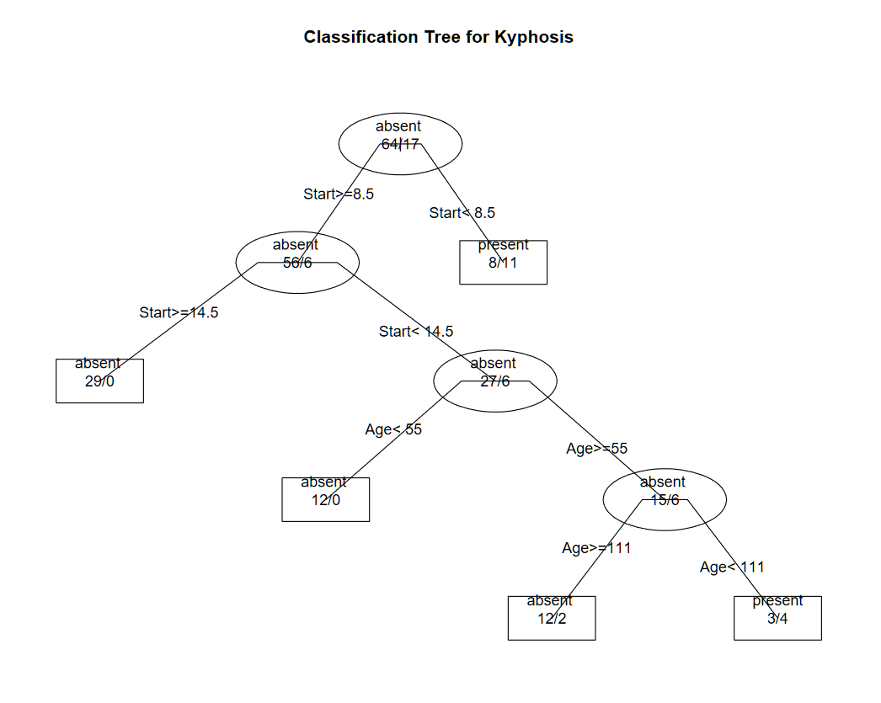
Classification Trees
Response variable is categorical (e.g., habitat type, presence or absence of a disease)
Notes:
From https://www.statmethods.net/advstats/cart.html

Slide 19
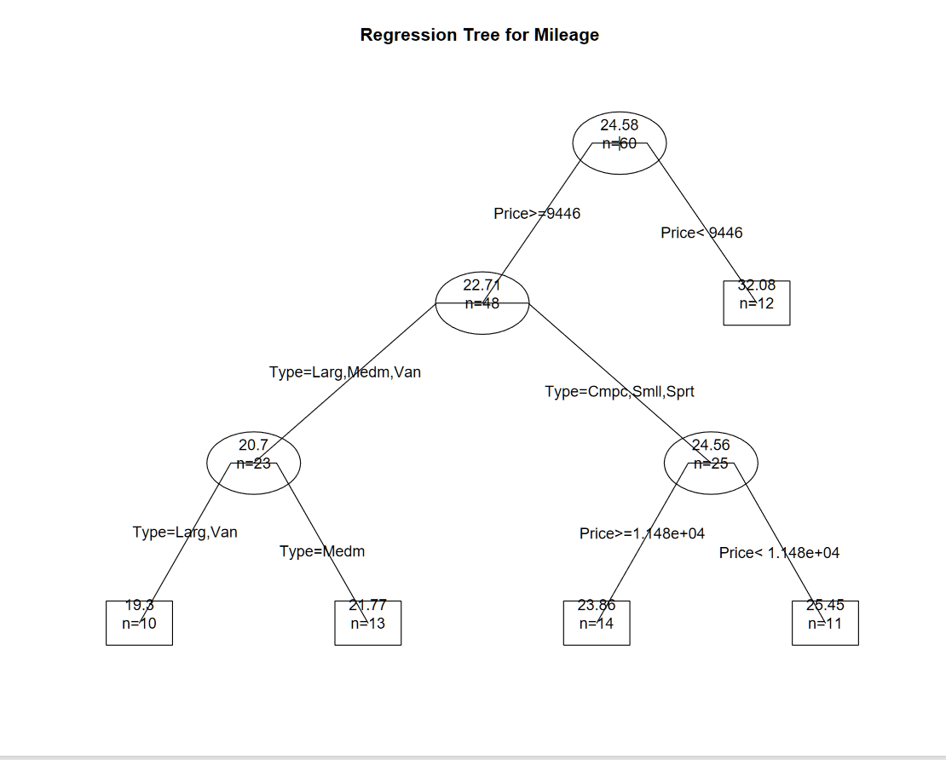
Regression Trees
Response variable is continuous (e.g., species richness or abundance)
Notes:
Predict car mileage from price, country, reliability, and car type

Slide 20
Summary
Discriminant analysis
Determining how explanatory variables discriminate between (known, a-priori) groups
Classification
Classify observations into groups based on similarity
MANOVA, MRPP
Test whether there are significant differences among groups
Classification and Regression Trees
Explore differences among groups as defined by a response variable (post-hoc groupings)

